Slide 1
Data@ANZ Program – Virtual Internship
Task : 1 Exploratory Data Analysis

Slide 2
Insights
1.The highest single transaction is 7081.09AUD and the account holder has an account in Queensland
2.The total amount transacted in various transaction types are
a) Pay/Salary : 1676576.85AUD
b) Payment :201794.00
C)Sales-Pos :157005.11AUD
d)Pos :152861.24AUD
e)Inter Bank :643314.00AUD
f)Phone Bank : 10716.00AUD
3.The most used transaction type used by both male and female is Sales-Pos
4.Highest Number of transactions made by Senior Citizen customers are 65 transactions and the transaction type is Sales-Pos
5. Highest Number of transactions made by customers below the age of 60 are 3869 transactions and the transaction type is Sales-Pos

Slide 3
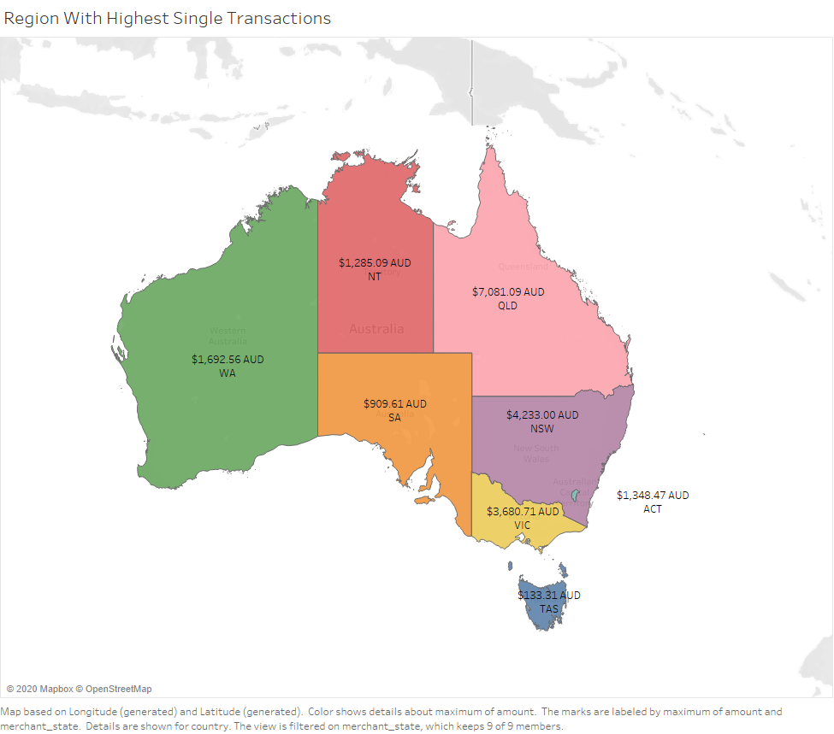

Slide 4
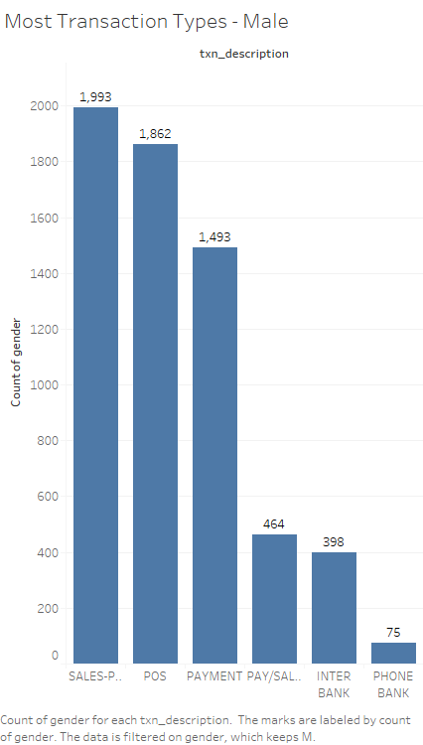
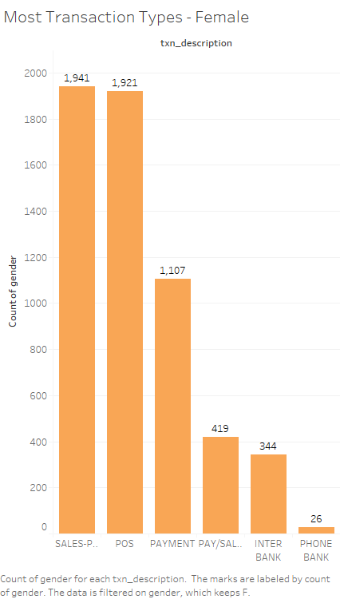

Slide 5
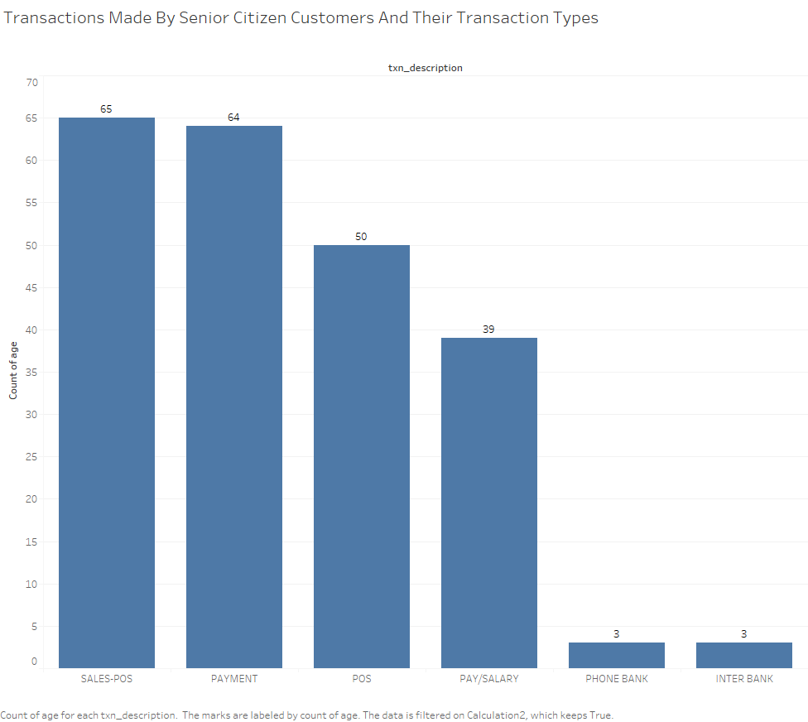
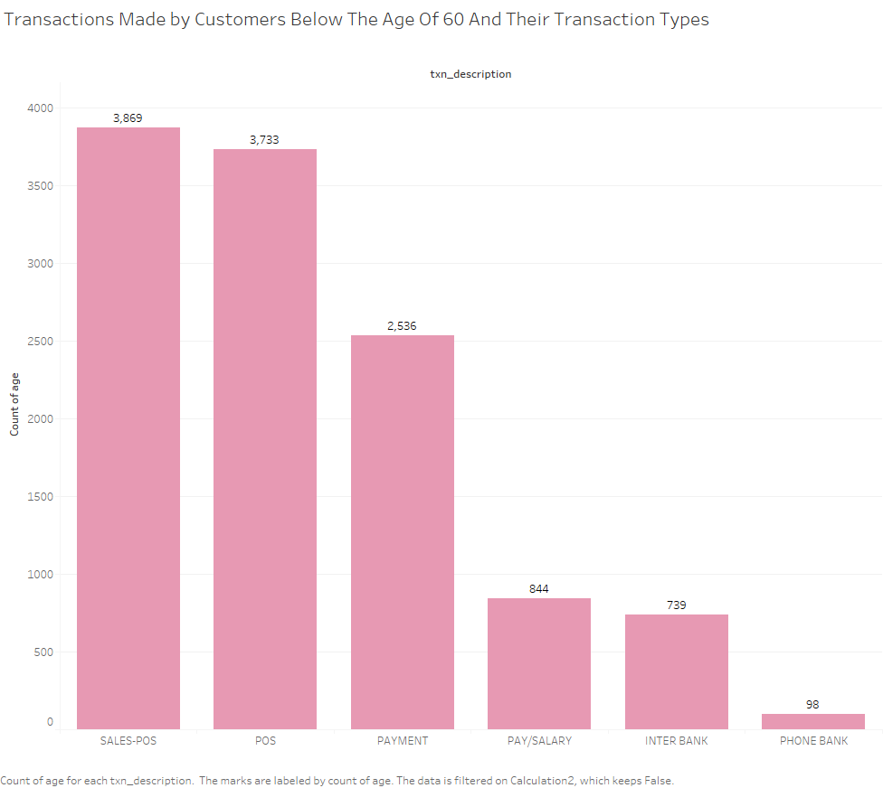

Slide 6
